Slide 1
Graphs
Mr. Channa Bankapur (channabankapur@pes.edu)
Department of CS&E, PES University

Slide 2
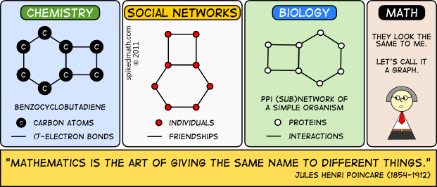
Graph Theory is the study of such visual models that shows the connections and relationships between different objects.

Slide 3
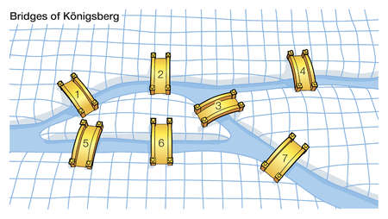
Leonhard Euler (1707-1783) published a paper to solve ancient “Seven Bridges of Konigsberg” problem in 1736. That’s when Graph Theory, as we know today, was born.
Seven Bridges of Konigsberg puzzle: Starting from a point on land, walk through all the seven bridges exactly once and return to the starting point.

Slide 4
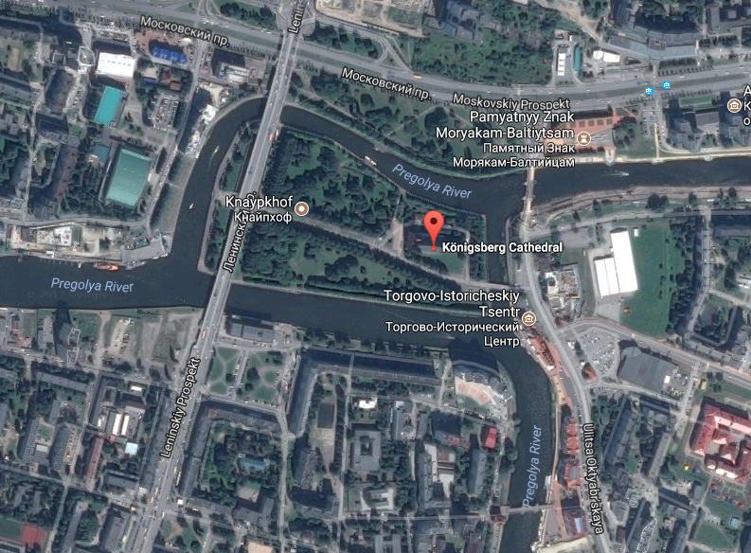

Slide 5
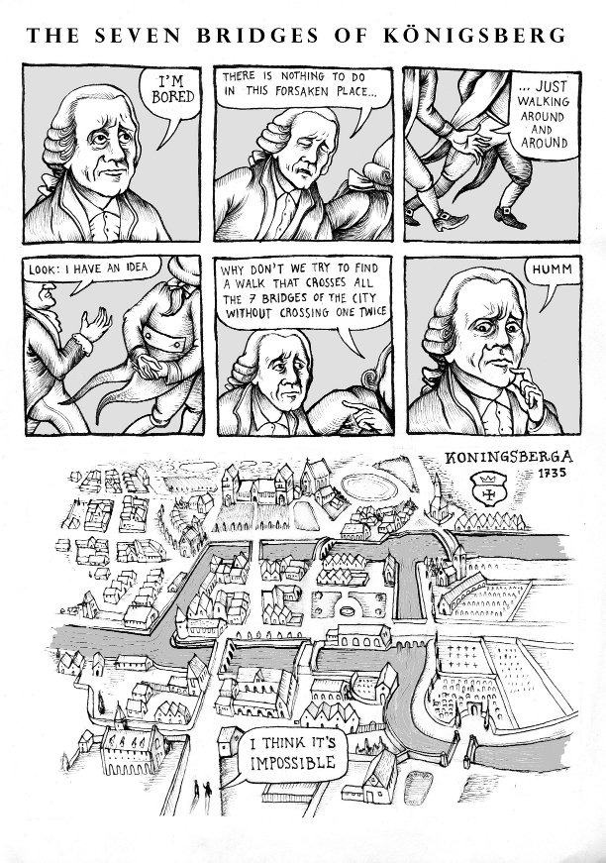
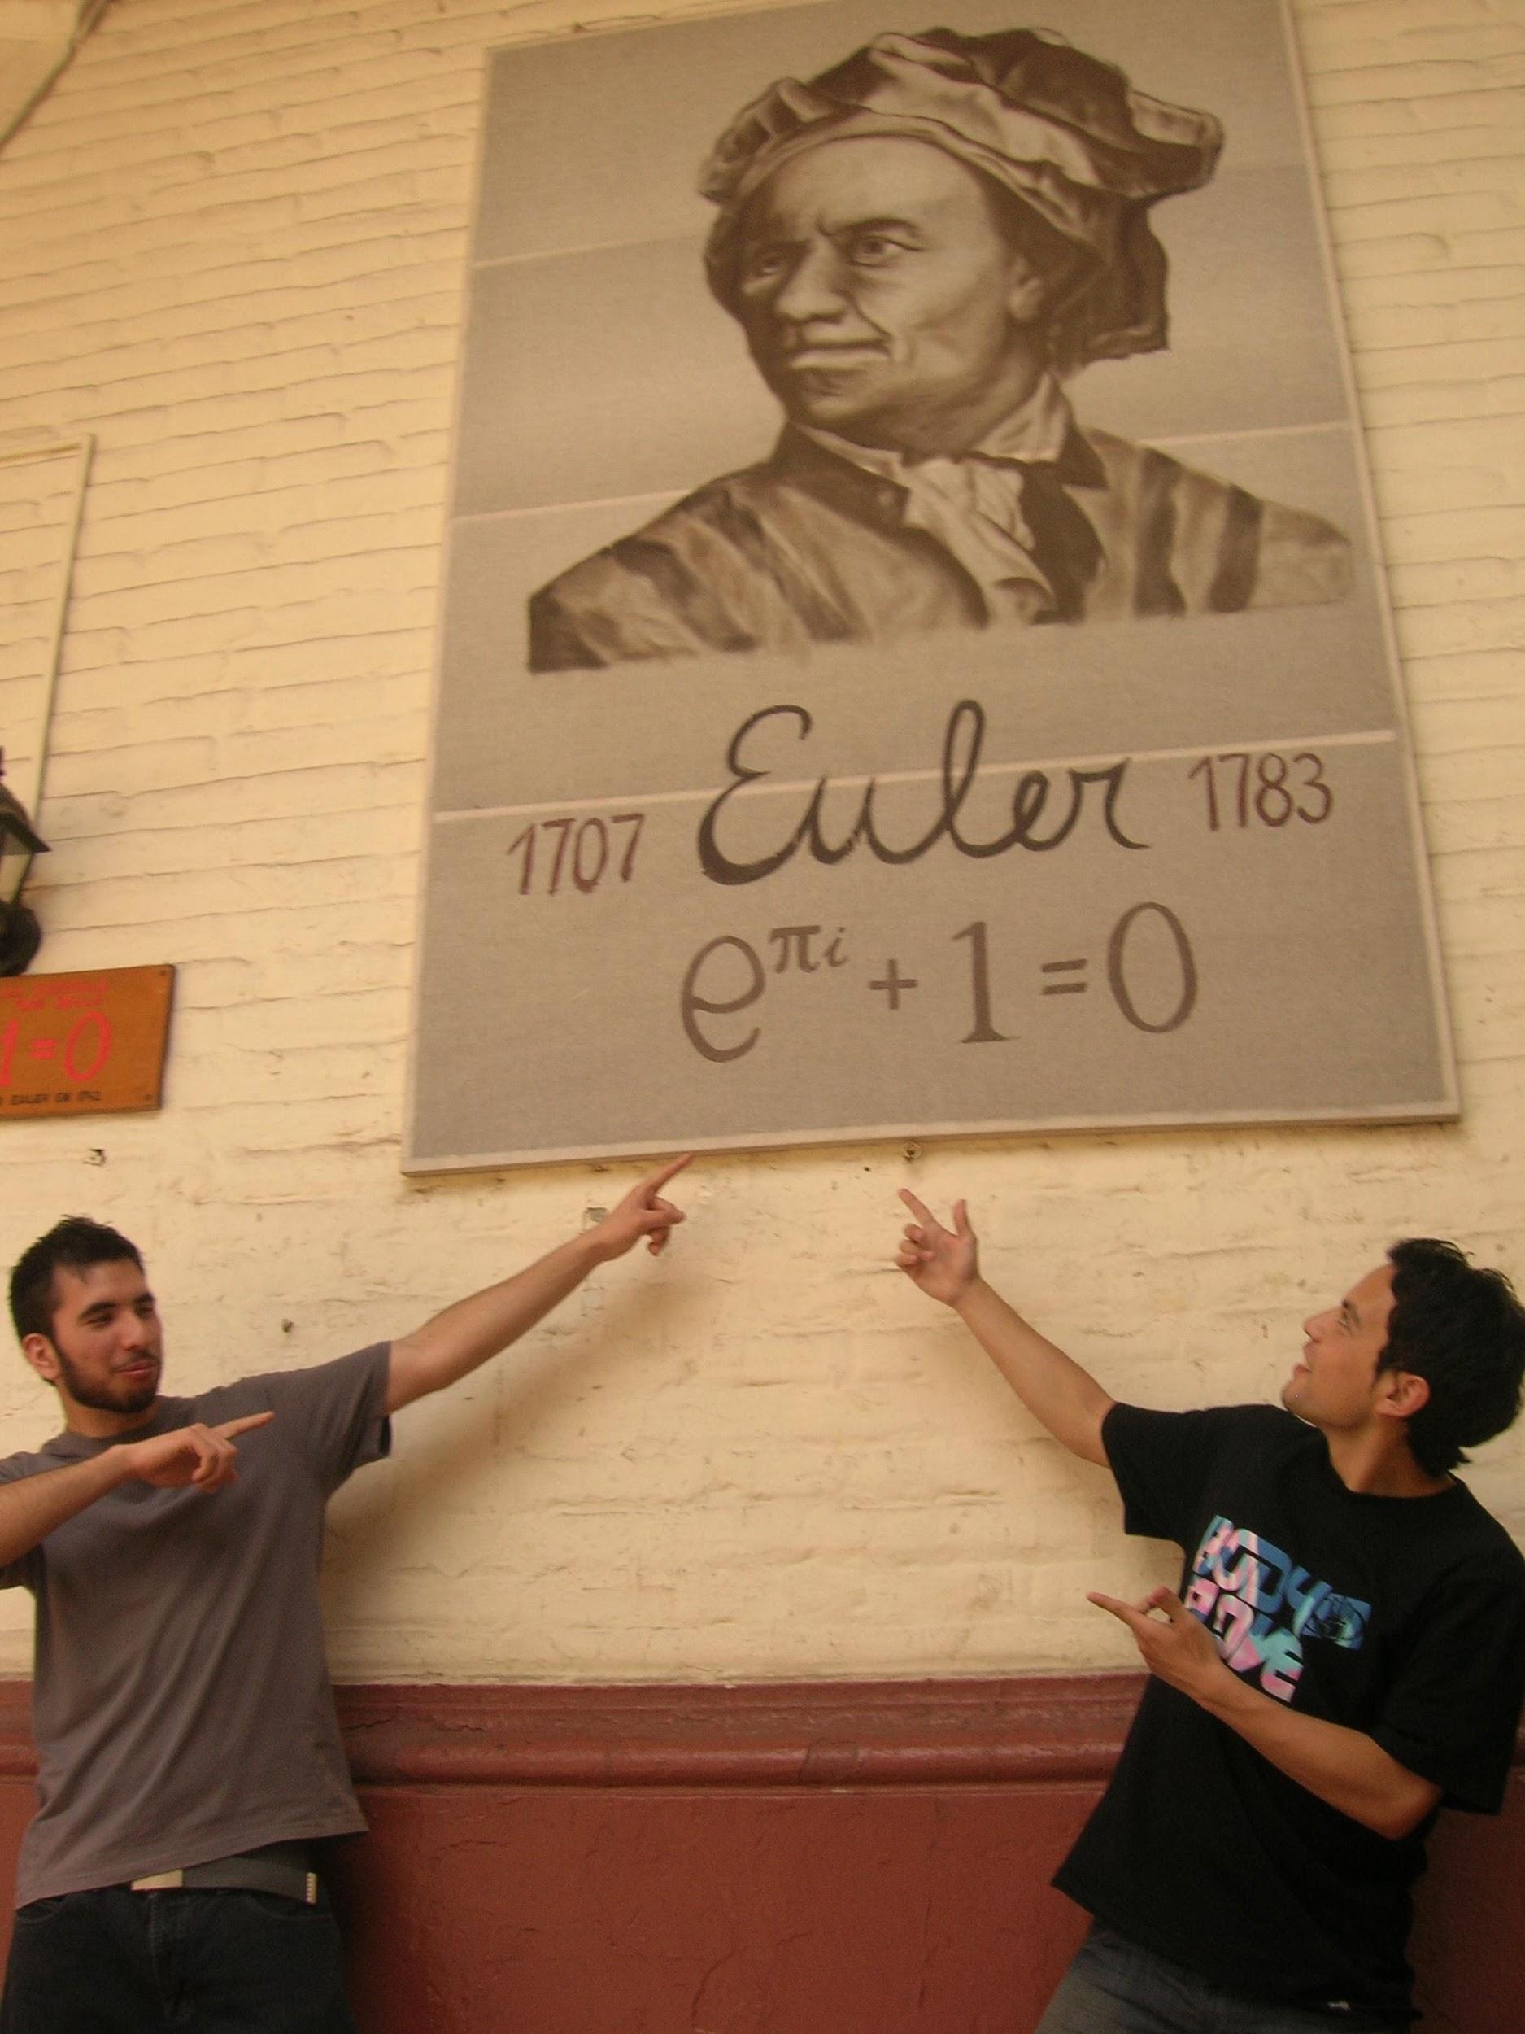

Slide 6
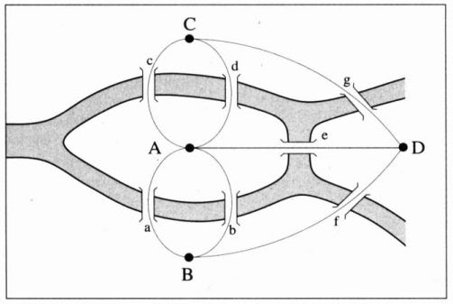
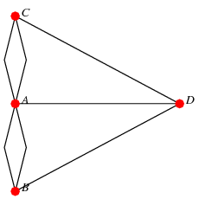
Graph Theory
Seven Bridges of Konigsberg problem solved by Euler

Slide 7
History of Graph Theory:
1736: Leonhard Euler wrote a paper to prove that the “7 bridges of Konigsberg” does not have a solution.
1847: G.R. Kirchhoff developed graph theory for the applications in electrical networks.
1850: A. De Morgan mentioned the four-color problem in a discussion.
1857: A. Cayley developed the theory to enumerate the isomers of saturated hydrocarbons.
1859: W.R. Hamilton invented a puzzle, which essentially asks to find a circuit (now known as Hamiltonian circuit) in a graph.
1936: D. Konig wrote the first book on Graph Theory.

Slide 8
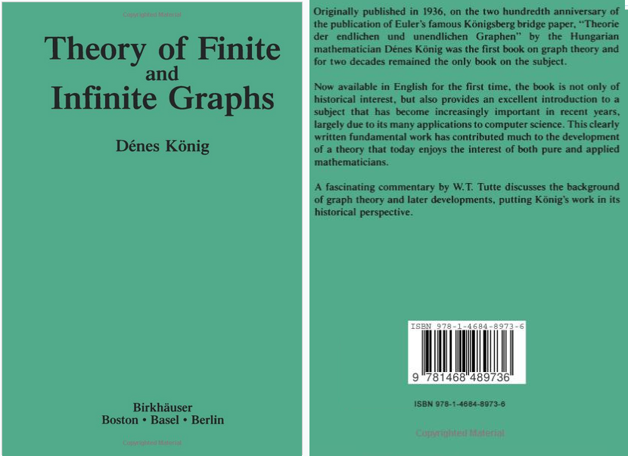

Slide 9
Graph Theory
What is a graph?
A graph (aka linear graph) G = (V, E) consists of a nonempty set of objects V = {v₁, v₂, …} called vertices, and another set E = {e₁, e₂, …} called edges, such that each edge e_{k} is identified with an unordered pair (v_{i}, v_{j}) of vertices.
A graph is discrete structure used to model a discrete set of objects which has pairwise relations between the objects.
Graphs are effective tools to study complex set of interconnected points. Graphs are not to be confused with bar charts, pie charts which often collectively called as graphs.

Slide 10
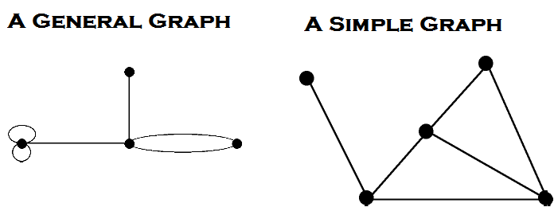
Vertices (aka Nodes, Points, Junctions)
Edges (aka Links, Branches, Lines, Arcs)
Endpoints of an edge belongs to the set of vertices
Adjacent vertices (shares a common edge)
Parallel edges (multiple edges between two vertices)
Self-loops (avoid using the term “loop” for this)
Simple graph (has neither self-loops nor parallel edges)
Multigraphs (parallel edges are allowed)
Pseudographs (parallel edges and self-loops are allowed)

Slide 11
Examples:
A simple graph: Facebook friend-connections among the students of this class. (No self-loops and no parallel edges)
A non-simple graph: Web graph
Graph of web pages with links where webpages are vertices and hyperlinks pointing to webpages are edges of the graph. A webpage may have link to the same page and a web page to point to some other web page multiple times. Google’s Pagerank algorithm uses a web-graph model.

Slide 12
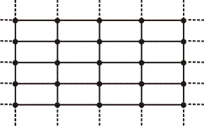
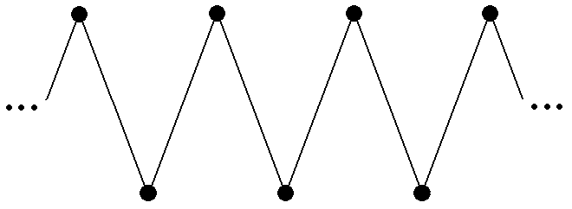
Infinite graphs: (number of vertices are infinite)

Slide 13
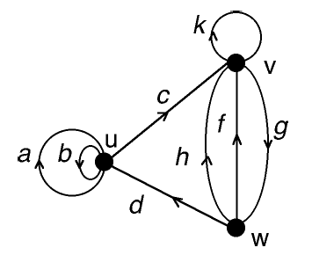
Directed and Undirected Graphs:
Eg: Facebook friend-connections among the students of this class is an undirected graph. (A friend-connection is always bidirectional)
Digraph: A directed graph often called as a digraph.
Arc: A directed edge is often called as an arc.
Eg: Twitter (or Google+) follower-following connections among the students of this class. If person A is following person B, a directed edge would be drawn from vertex A to vertex B. Person B may or may not follow person A.

Slide 14
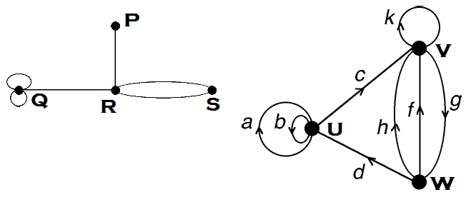
Degree (aka valence) of a vertex v is the number of edge-ends incident on v.
A self-loop contributes two to the degree of a vertex.
In a digraph, Degree of a vertex =
Out-degree of the vertex + In-degree of the vertex

Slide 15
Theorem: The sum of the degrees in a graph equals twice the number of edges.
Corollary: The number of vertices of odd degree in a graph is always even.
The above theorem is aka The Handshaking Theorem because of the following analogy. The sum, over the set of people at a party, of the number of people a person has shaken hands with, is even.
Theorem: In a simple graph with at least two vertices, there would be two vertices with the same degree.

Slide 16
Example: Friend-connections among the students of this class.
Sum of the number of friend-connections of each student of this class is even.
There are even number of students having odd number of friend-connections.
There are two students having same number of friend-connections.

Slide 17
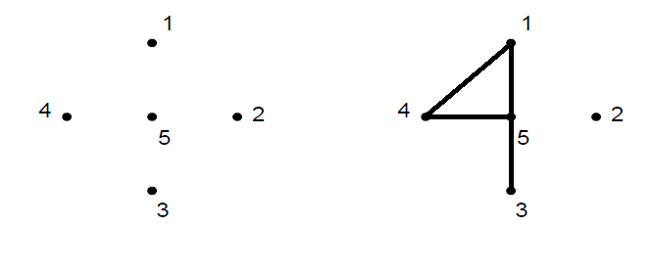
Isolated vertex: All in the 1st graph and vertex 2 in the 2nd.
Pendant vertex: Vertex 3 in the 2nd graph.
Null graph: First graph

Slide 18
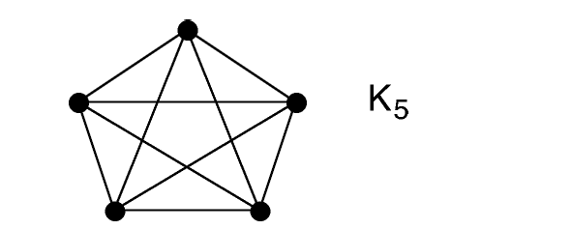
Special Graphs:
A Complete Graph is a simple graph such that every pair of vertices is joined by an edge.
The complete graph with n vertices is denoted as K_{n}.
Q: How many edges does a complete graph K_{n} has?

Slide 19
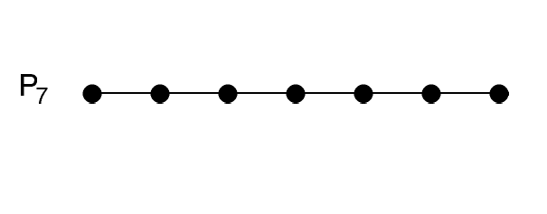
Special Graphs:
A Path Graph has vertices v₁, v₂, …, v_{n} and edges e₁, e₂, …, e_{n-1}, such that edge e_{k} joins vertices v_{k} and v_{k+1}.
The path graph with n vertices is denoted as P_{n}.
Q: How many edges does a path graph P_{n} has?

Slide 20
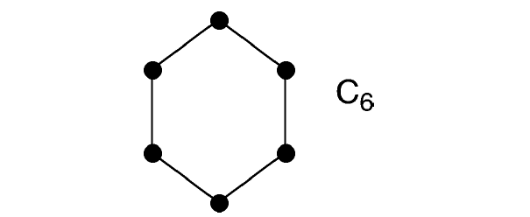
Special Graphs:
A Cycle Graph has vertices v₀, v₁, …, v_{n-1} and edges e₀, e₁, …, e_{n-1}, such that edge e_{k} joins vertices v_{k} and v_{k+1 (mod n)}.
The cycle graph with n vertices is denoted as C_{n}.
Q: How many edges does a cycle graph C_{n} has?

Slide 21
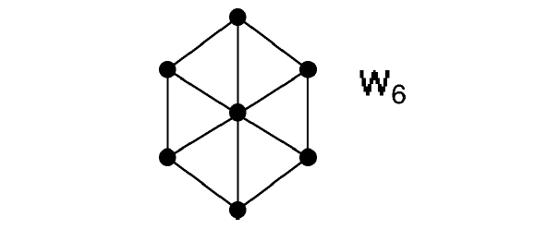
Special Graphs:
A Wheel Graph has a hub vertex joined to every other vertex and a cycle through all the other vertices.
The wheel graph whose rim is an n-cycle is denoted as W_{n}.
Q: How many edges does a wheel graph W_{n} has?

Slide 22
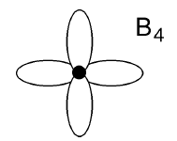
Special Graphs:
A bouquet is a graph with only one vertex.
The bouquet on n edges is denoted by B_{n}.

Slide 23
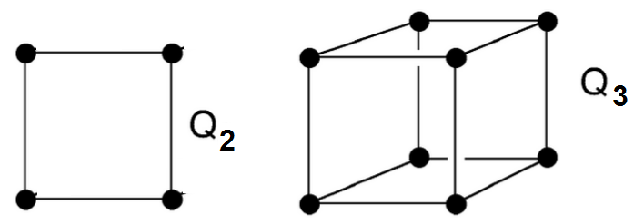
Special Graphs:
The cube graph of dimension n, denoted by Q_{n}, is an n-dimensional cube where each corner is a vertex and each edge of the figure is an edge of the graph.

Slide 24
Regular Graphs:
A graph (not just a simple graph) is regular if every vertex has the same degree.
Are the following graphs are regular?
A simple graph
A complete graph K_{n}
A path graph P_{n}
A cycle graph C_{n}
A cube graph Q_{n}
A bouquet graph B_{n}
A wheel graph W_{n}
A null graph

Slide 25
Regular Graphs:
A graph (not just a simple graph) is regular if every vertex has the same degree.
The following graphs are regular:
Not all simple graphs are regular.
The complete graph K_{n} is regular of degree n-1.
A cycle graph is regular of degree 2.
The cube graph Q_{n} is regular of degree n.
The bouquet graph B_{n} is regular of degree 2n.
The wheel graph W₃ is regular. It is isomorphic to complete graph K₄. W_{n} with n>3 are not regular graphs.
All null graphs are regular of degree 0.

Slide 26
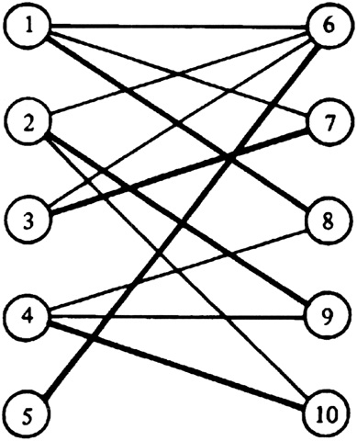
Bipartite Graphs
A graph is bipartite if its vertex set can be partitioned into two subsets such that every edge joins a vertex in one subset to a vertex in the other subset.
Eg: A set of people and mobile-makes (Android, iPhone, etc.) linked by a person owning a mobile device. An edge is between a person and a mobile device.
Eg: A path graph is bipartite.
Eg: A cycle graph of even degree is bipartite.

Slide 27
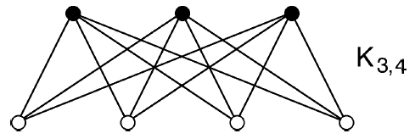
A simple graph is complete bipartite if it is bipartite so that every vertex in one cell is joined to every vertex in the other cell.
Complete Bipartite graph K_{m,n} has m*n edges.

Slide 28
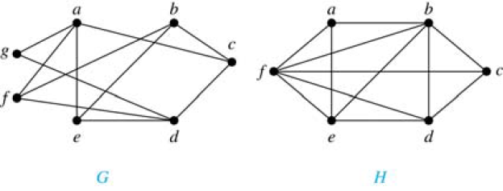
Q: Are the following graphs bipartite?
Ans: …

Slide 29
Theorem: A simple graph is bipartite if and only if it is possible to assign one of two different colors to each vertex of the graph so that no two adjacent vertices are assigned the same color.
Eg: Graph G is bipartite and H is not.

Slide 30
 | # vertices | # edges | Bipartite? | Regular graph?
K_{n} (n≥1)
P_{n} (n≥1)
C_{n} (n≥3)
W_{n} (n≥3)
B_{n} (n≥1)
Q_{n} (n≥1)

Slide 31
 | # vertices | # edges | Bipartite? | Regular graph?
K_{n} (n≥1) | n | n(n-1)/2 | When n ≤ 2 | Always
P_{n} (n≥1) | n | n-1 | Always | When n = 2
C_{n} (n≥3) | n | n | When n is even | Always
W_{n} (n≥3) | n+1 | 2n | Never | When n = 3
B_{n} (n≥1) | 1 | n | Undefined | Always
Q_{n} (n≥1) | 2^{n} | n * 2^{n-1} | Always | Always

Slide 32
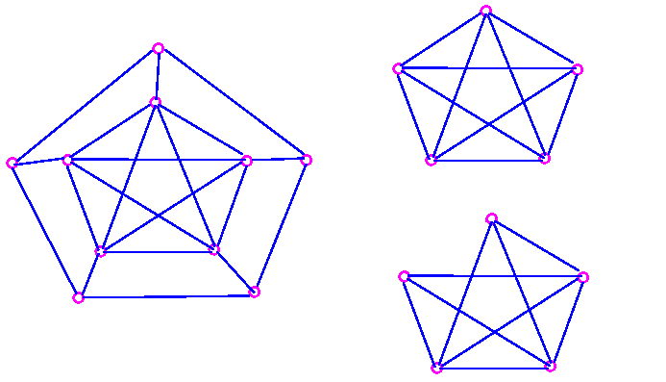
Subgraphs:
A subgraph of a graph G=(V,E) is a graph H=(U,D) such that U⊆V and D⊆E.
Note: Since the H=(U,D) is also a graph, it follows that U must contain all the endpoints of the edges in D.

Slide 33
Q: How many subgraphs of the following graph (represented as adjacency lists) has?
a: b c d
b: a
c: a
d: a
Ans: …

Slide 34
Q: How many subgraphs of the following graph (represented as adjacency lists) has?
a: b c d
b: a
c: a
d: a
Ans: # subgraphs with 4 vertices
+ # subgraphs with 3 vertices
+ # subgraphs with 2 vertices
+ # subgraphs with 1 vertex
= …

Slide 35
Q: How many subgraphs of the following graph (represented as adjacency lists) has?
a: b c d
b: a
c: a
d: a
Ans: # subgraphs with 4 vertices
+ # subgraphs with 3 vertices
+ # subgraphs with 2 vertices
+ # subgraphs with 1 vertex
= (2³) + (2² + 2² + 2² + 2⁰) + (2¹ + 2¹ + 2¹ + 2⁰ + 2⁰ + 2⁰) + (4)
= 8 + 13 + 9 + 4
= 34

Slide 36
Q: How many subgraphs a K₄ has?
Ans:

Slide 37
Q: How many subgraphs a K₄ has?
Ans:
2⁶ + 4 * 2³ + 6 * 2¹ + 4 = 112
Number of subgraphs of K_{n} = f(n)
f(n) = 2^{C(n,2)} + n * 2^{C(n-1,2)} + C(n, n-2) * 2^{C(n-2,2)} + … + n.
f(n) = C(n,n) 2^{C(n,2)} + C(n,n-1) 2^{C(n-1,2)} + C(n, n-2) 2^{C(n-2,2)} + … + C(n,2) 2^{C(2,2)} + C(n,1) 2⁰.
f(n) = Summation for i= n downto 1 ( C(n,i) 2^{C(i,2)})
Note that C(1,2) = 0.

Slide 38
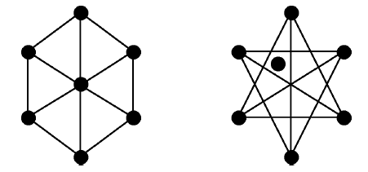
The edge-complement (aka complementary graph) of a simple graph G is the graph G (read: G-bar) on the same vertex set as G, such that two vertices of G (G-bar) are joined by an edge if and only if they are not adjacent in G.

Slide 39
Q: How many edges are there in the edge-complement of a simple regular graph with 12 vertices and degree 3?
Ans: …
Q: How many edges are there in the edge-complement of a simple regular graph with 15 vertices and degree 5?
Ans: …

Slide 40
Q: How many edges are there in the edge-complement of a simple regular graph with 12 vertices and degree 3?
Ans: # edges in K₁₂ - {# edges in a simple regular graph with 12 vertices and degree 3}
= 11 * 12 / 2 - {12 * 3 / 2}
= 66 - 18
= 48
Q: How many edges are there in the edge-complement of a simple regular graph with 15 vertices and degree 5?
Ans: Such a graph cannot exist.

Slide 41
Representation of Graphs:
Incidence Table
Incidence Matrix
Adjacency List
Adjacency Matrix

Slide 42
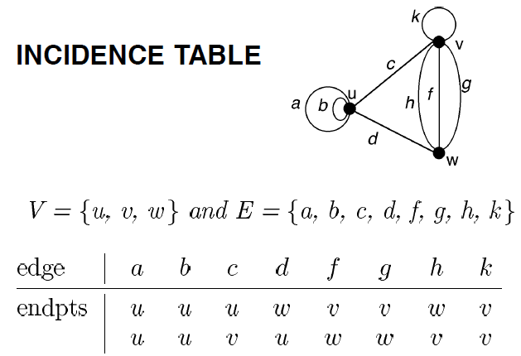

Slide 43
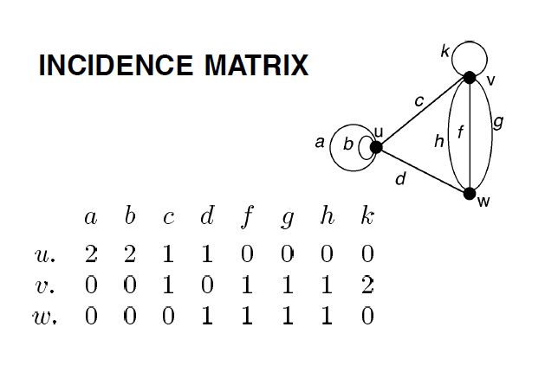
Theorem: The sum of the degrees in a graph equals twice the number of edges.
Proof: Incidence matrix has a proof.

Slide 44
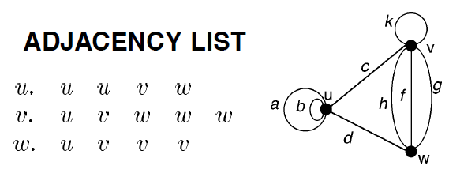
An adjacency list for a vertex v of graph G is a list containing each vertex w of G once for each edge between v and w.

Slide 45
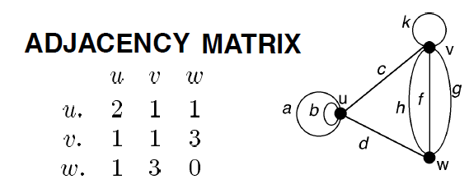
For non-multigraph, the matrix will be a 0-1 matrix. For a pair of vertices i and j, (i, j) is ‘1’ if they are adjacent, ‘0’ otherwise.
For higher number of vertices and far-from-a-complete-graph, it’ll be a sparse matrix.

Slide 46
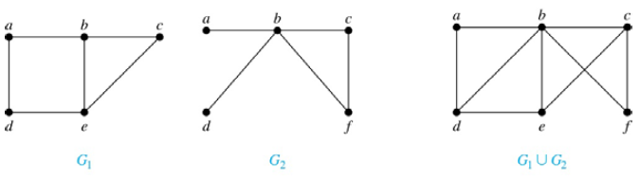
Union of two simple graphs:
The Union of two simple graphs G₁ = (V₁, E₁) and G₂ = (V₂, E₂) is the simple graph with vertex set V₁ ∪ V₂ and edge set E₁ ∪ E₂. The union of G₁ and G₂ is denoted by G₁ ∪ G₂.

Slide 47
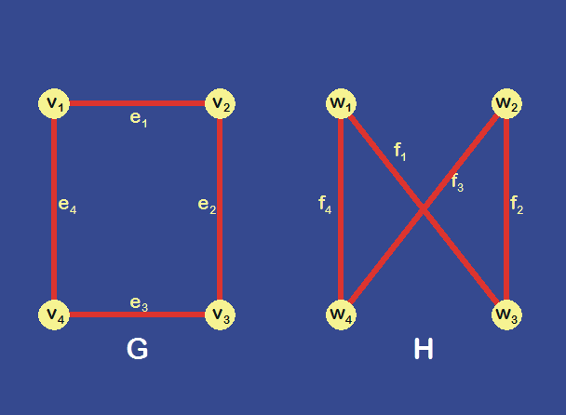
In what way the two graphs G and H are similar?

Slide 48
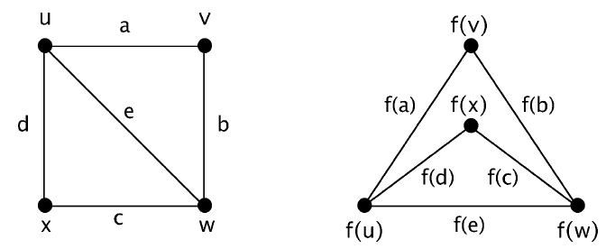
Isomorphic Graphs: isos=“same”, morphe=“form”
The simple graphs G₁=(V₁,E₁) and G₂=(V₂,E₂) are isomorphic if there is an one-to-one correspondence function f from V₁ to V₂ with the property that u and v are adjacent in G₁ iff f(u) and f(v) are adjacent in G₂, for all u and v in V₁. Such a function f is called an isomorphism.

Slide 49
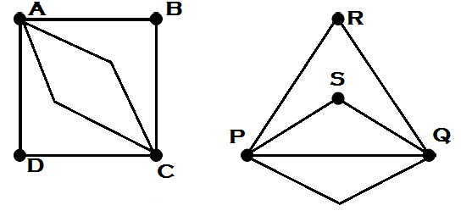
Isomorphic Graphs:
The graphs G=(V,E) and H=(U,D) are isomorphic if there is an one-to-one correspondence function f from V to U
such that ∀u,v ∈ V, the number of edges between u and v equals the number of edges between f(u) and f(v).

Slide 50
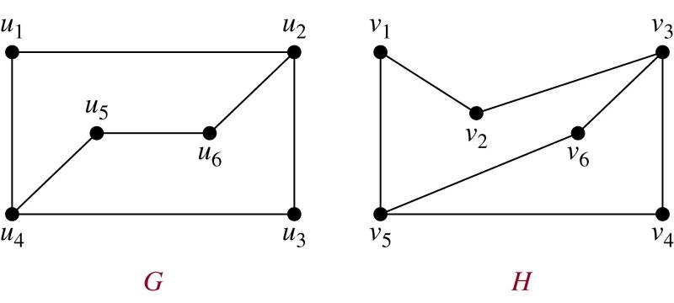
Q: Are these graphs isomorphic?

Slide 51
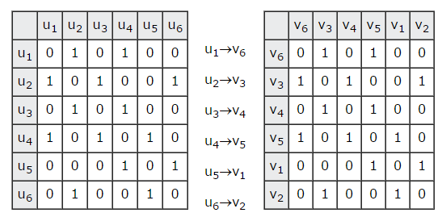

Slide 52
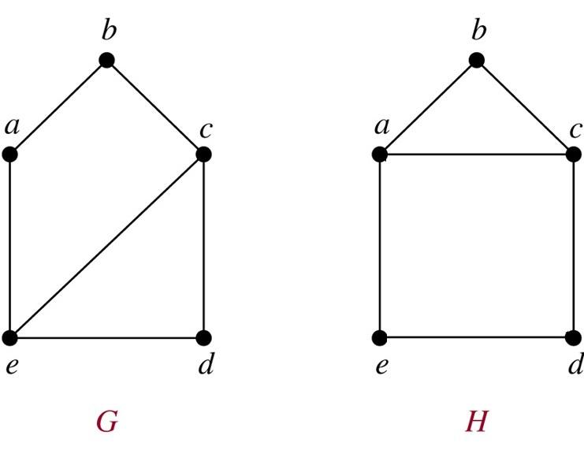
Q: Are these graphs isomorphic?
Ans: Yes/No

Slide 53
Q: Are these graphs isomorphic?
Ans: They are isomorphic.

Slide 54
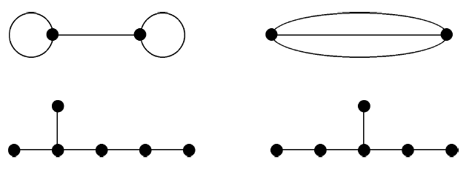
Some necessary conditions for two graphs to be isomorphic:
the same number of vertices
the same number of edges
the same degree sequence (set of all vertex degrees)
But, they are not sufficient.
Q: Are these pair of graphs isomorphic?
Even though they satisfy the above necessary conditions, they are not isomorphic.

Slide 55
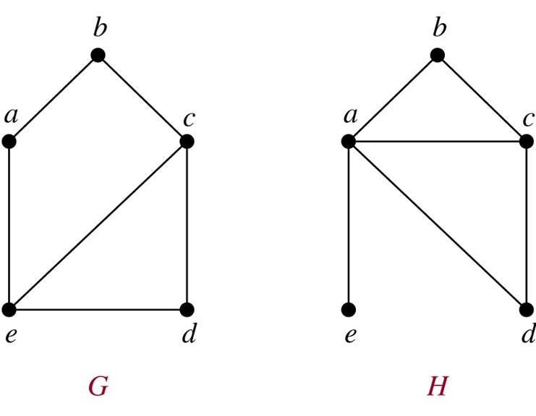
Q: Are these graphs isomorphic?

Slide 56
Degree sequences: 2, 2, 2, 3, 3
1, 2, 2, 3, 4
Therefore, they are not isomorphic.

Slide 57
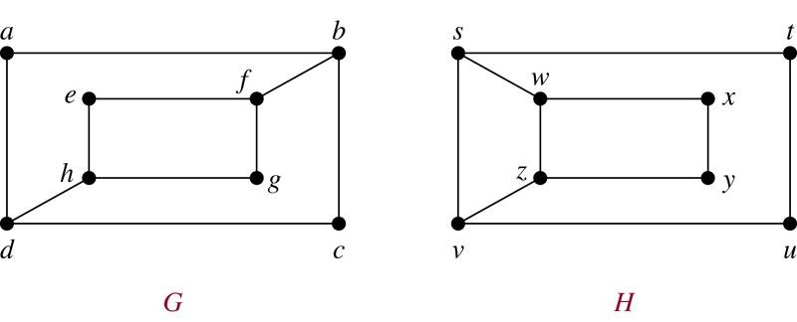
Q: Are these graphs isomorphic?
Ans: Yes/No

Slide 58
Q: Are these graphs isomorphic?
Ans: No, they are not.

Slide 59
Algorithm to find whether given two graphs are isomorphic:
The best known algorithms for solving this problem are still exponential time worst-case time complexity in terms of the number of vertices of the graph.
However, there are algorithms where the average case time complexity is O(n).
Currently, NAUTY is the fastest isomorphism testing algorithm. (http://cs.anu.edu.au/people/bdm/nauty/)
It is hoped that a polynomial worst-case time algorithm can still be found. This is thus an open problem. Maybe one of you will solve it some day!

Slide 60
Path in a graph (including non-simple graphs):
Let n be a nonnegative integer and G a graph. A path of length n from vertices u to v in G is a sequence of edges e₁, e₂, …, e_{n} of G such that e₁ is associated with (x₀, x₁), e₂ with (x₁, x₂) and so on, with e_{n} associated with (x_{n-1}, x_{n}), where x₀ = u and x_{n} = v.
When there are no multiple edges in the graph (non-multigraph), the path is denoted by its vertex sequence x₀, x₁, …, x_{n}.
A path of length greater than zero that begins and ends at the same vertex is called a circuit (aka cycle).
A path or circuit is called simple if it does not contain the same edge more than once.

Slide 61
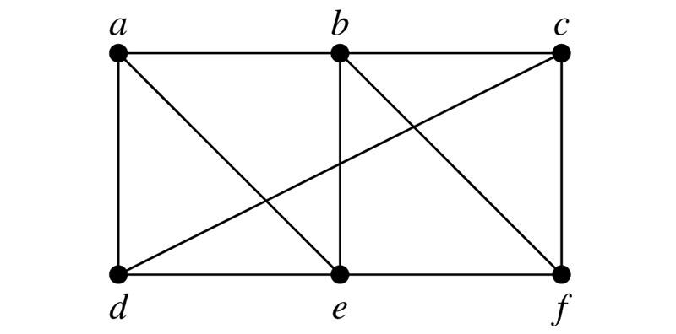
<a, b, e, f> simple path of length 3
<a, b, e, f, b, c> simple path of length 5
<a, b, e, b, c> non-simple path of length 4
<a, b, d> not a valid path because (b,d) is not an edge
<a, e, d, a> simple circuit of length 3
<a, e, d, e, d, a> non-simple circuit of length 5
<a, e, b, f, e, d, a> ??
<a, b, c, b> ??

Slide 62
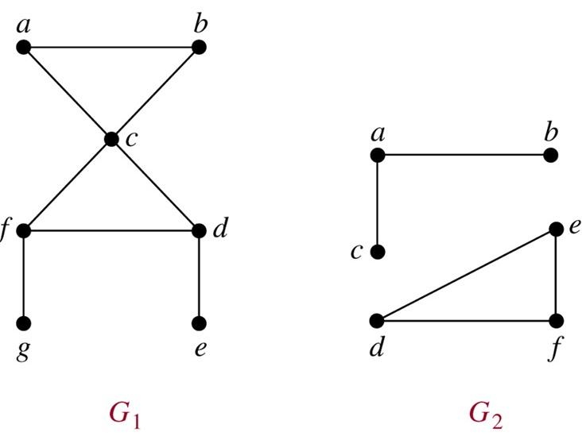
An undirected graph is called connected if there is a path between every pair of distinct vertices of the graph.
Theorem: There is a simple path between every pair of distinct vertices of a connected undirected graph.
Graph G₁ is connected
and G₂ is not.
Every connected
graph with n
vertices has at least
n-1 edges.

Slide 63
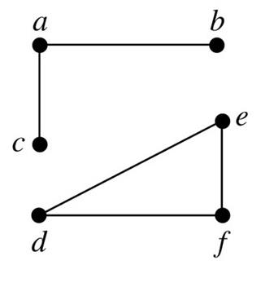
A connected component (or just component) of a graph G is a connected subgraph of G that is not a proper subgraph of another connected subgraph of G.
The following graph has two components.

Slide 64
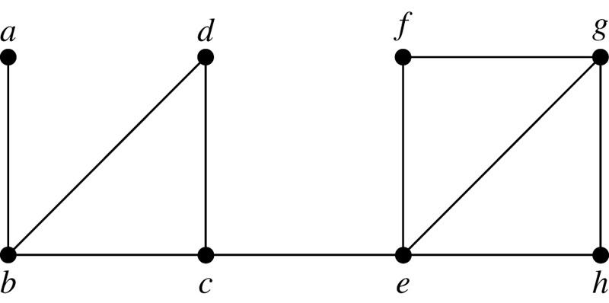
Cut vertices (aka articulation points):
Vertices that when removed along with incidence edges, produces a subgraph with more connected components than the original graph.
b, c, and e are the only cut vertices in the following graph.

Slide 65
Cut edges (aka bridges):
Edges that when removed, produces a subgraph with more connected components than the original graph.
(c,e) and (a,b) the only cut edges in the following graph.

Slide 66
Cut set:
A set of edges that when removed, produces a subgraph with more connected components than the original graph, provided removal of no proper subset of these edges disconnects G.
{(c,e)}, {(a,b)}, and {(b,d), (b,c)} are some of the cut sets in the following graph.

Slide 67
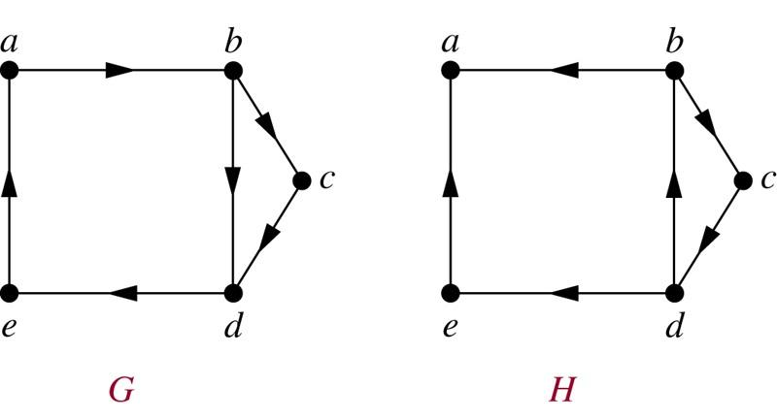
A directed graph is strongly connected if there is a path from a to b and from b to a whenever a and b are vertices in the graph. Graph G shown below is a strongly connected graph.
A directed graph is weakly connected if there is a path between every two vertices in the underlying undirected graph. Graph H shown below is a weakly connected graph, but not a strongly connected graph.

Slide 68
Strongly connected components:
The subgraphs of a directed graph G that are strongly connected but not contained in larger strongly connected subgraphs, that is, the maximal strongly connected subgraphs, are called the strongly connected components of G. In the graphs shown below, graph H has three strongly connected components with the vertices {a}, {e} and {b, c, d}.

Slide 69
Euler Circuit/Path in a connected multigraph:
A simple circuit/path containing every edge of the graph.
Seven Bridges of Konigsberg: Starting from a point on land, walk through all the seven bridges exactly once and return to the starting point. It essentially means, is the graph shown below has an Euler circuit?

Slide 70
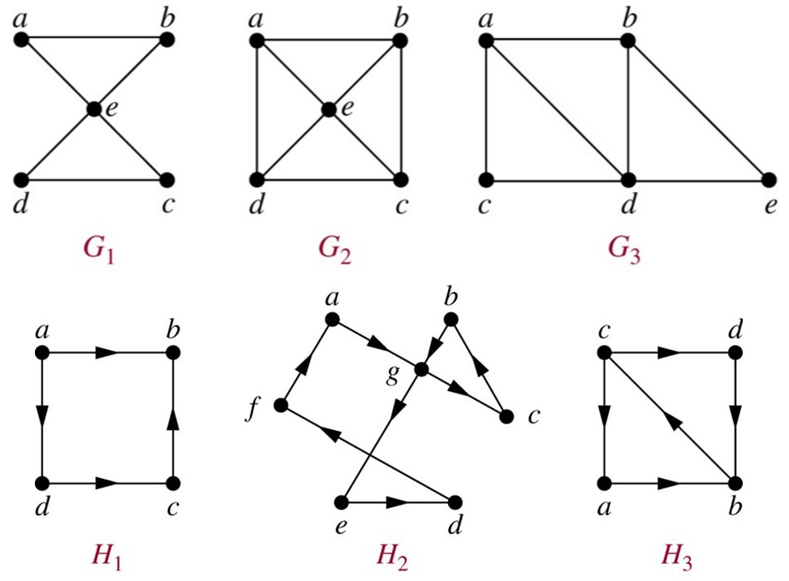
Euler Circuit/Path in a connected multigraph:
A simple circuit/path containing every edge of the graph.

Slide 71
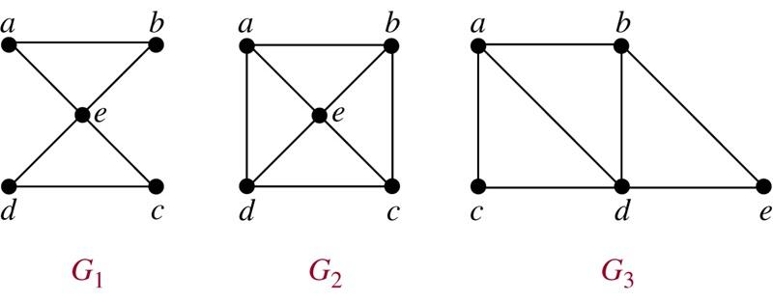
Euler Circuit/Path in a connected multigraph:
A simple circuit/path containing every edge of the graph.
G₁ has an Euler circuit.
G₂ does not have any Euler circuits or Euler paths.
G₃ has an Euler path, but not an Euler circuit.

Slide 72
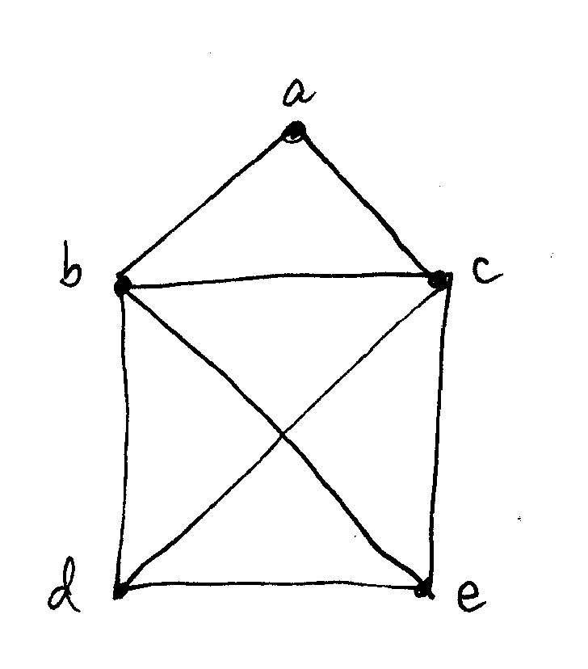
Draw a picture in continuous motion without lifting a pen/pencil so that no part of the picture is retraced.
It essentially means, draw the graph which has an Euler circuit or an Euler path.

Slide 73
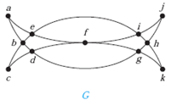
Draw a picture in continuous motion without lifting a pen/pencil so that no part of the picture is retraced.
It essentially means, draw the graph which has an Euler circuit or an Euler path.

Slide 74
Theorem:
A connected multigraph with at least two vertices has an Euler circuit if and only if each of its vertices has even degree.
To prove:
“It has an Euler circuit → each of its vertices has even degree”
OR
“There is vertex of odd degree → It does not have an Euler ckt”
AND (its converse statement)
“Each of its vertices has even degree → It has an Euler circuit”.

Slide 75
Euler Circuit in a connected multigraph:
Necessary and Sufficient Conditions:
Has an Euler circuit → necessary condition
Sufficient condition → has an Euler circuit

Slide 76
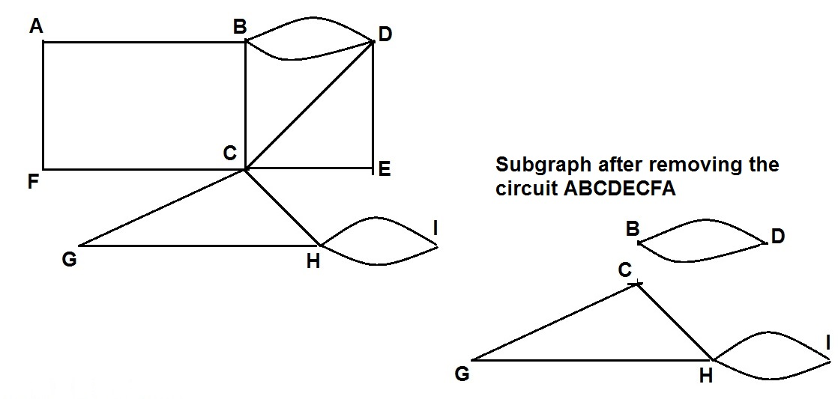
Euler Circuit/Path in a connected multigraph:
Necessary and Sufficient Conditions:
Has an Euler circuit → all vertices have even degree
All vertices have even degree → has an Euler circuit

Slide 77
Theorem:
A connected multigraph with at least two vertices has an Euler circuit if and only if each of its vertices has even degree.
To prove:
“It has an Euler circuit → each of its vertices has even degree” AND
“Each of its vertices has even degree → It has an Euler circuit”.
Theorem:
A connected multigraph has an Euler path but not an Euler circuit if and only if it has exactly two vertices of odd degree.
Proof: Similar to the above theorem.

Slide 78
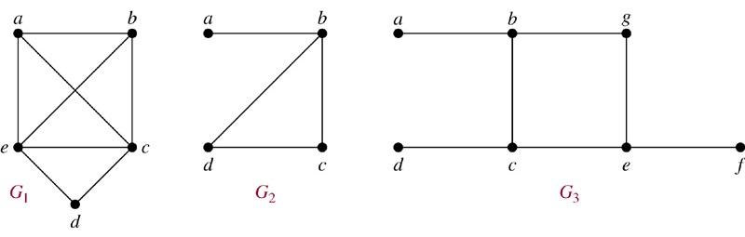
Hamilton Circuit/Path in a Graph:
A simple circuit/path passing through every vertex of the graph exactly once.
G₁ has a Hamiltonian circuit: abcdea
G₂ has a Hamiltonian path, but not circuit: abcd
G₃ has neither Hamiltonian path nor Hamiltonian circuit.

Slide 79

G has a Hamiltonian path, but not circuit: edabc
H has Hamiltonian path but not Hamiltonian circuit.

Slide 80


Icosian Puzzle: Invented by Sir William Rowan Hamilton
It’s a wooden dodecahedron with a peg at each vertex and string is given. The puzzle is to start with a vertex, pass through every vertex exactly once and end at the starting vertex.

Slide 81

Icosian Puzzle: A solution
* Abhimanyu finds an Hamilton path, but Arjuna can find an Hamilton circuit.

Slide 82
Hamilton Circuits: Necessary conditions
A graph has an Hamiltonian circuit only if
Graph has at least n edges, where n = |V|.
Graph has no pendant vertices.
Graph has no cut vertex.
…
Any vertex with degree two will have both the edges in any Hamilton Circuits.

Slide 83
Hamilton Circuits: Sufficient Conditions
A graph has an Hamiltonian circuit if
it is a cycle graph C_{n}
it is a wheel graph W_{n}
it is a complete graph K_{n} where n >= 3.
…

Slide 84
Hamilton Circuits: Sufficient Conditions
No useful necessary and sufficient conditions for the existence of Hamilton circuits are known, and hence the best known algorithms for finding an Hamilton circuit have exponential worst-case time complexity.
The more edges a graph has, the more likely it is to have a Hamilton circuit.
K_{n} graph with n ≥ 3, has a Hamilton Circuit.
Adding edges to a graph with a Hamilton circuit does not take away the Hamilton circuit it already has.

Slide 85
Hamilton Circuits: Sufficient Conditions
K_{n} graph where n ≥ 3, has a Hamilton Circuit.
Diracs’s Theorem: (covers above condition)
If G is a simple graph having n vertices with n ≥ 3 such that the degree of every vertex in G is at least n/2, then G has a Hamilton Circuit.
Ore’s Theorem: (covers above theorem)
If G is a simple graph having n vertices with n ≥ 3 such that deg(u) + deg(v) ≥ n for every pair of nonadjacent vertices u and v in G, then G has a Hamilton Circuit.
Bondy-Chvatal theorem (covers above theorem).

Slide 86

Join three houses to each of three separate utilities.
Is it possible to join these houses and utilities so that none of the connections cross?
That is, can K_{3,3} be drawn in the plane so that no two of its edges cross?

Slide 87


Planar Graphs: A graph is called planar if it can be drawn on a plane without any edges crossing. Such a drawing is called a planar representation of the graph.

Slide 88


Slide 89

A planar representation of
a graph splits the plane
into regions, including an
unbounded region.
Theorem: Euler’s Formula
Let G be a connected planar simple graph with e edges and v vertices. Let r be the number of regions in a planar representation of G. Then r = e - v + 2.
Proof: Construct a sequence of subgraphs G₁, G₂, …, G_{e} = G.
G_{i} is a connected planar simple graph obtained by adding an edge to G_{i-1} where at least one of endpoints of the edge is already in G_{i-1}.
Proof of “r = e - v + 2” by induction.

Slide 90

Theorem: Euler’s Formula
Let G be a connected planar simple graph with e edges and v vertices. Let r be the number of regions in a planar representation of G. Then r = e - v + 2.
Proof: by induction

Slide 91


Slide 92

Degree of a region: Number of edges on the boundary of the region.
Theorem: In a connected planar simple graph G with e edges and v vertices, e ≤ 3v - 6 when v ≥ 3.
Proof: 2e ≥ 3r because degree of each region is at least 3.
2e ≥ 3(e-v+2)
2e ≥ 3e - 3v + 6
3e - 2e ≤ 3v - 6
e ≤ 3v - 6
It also demonstrates K₅ cannot be planar.

Slide 93
Theorem: A connected planar simple graph G has a vertex of degree not exceeding 5. That is, ∃v∈V deg(v) ≤ 5
Proof: e ≤ 3v - 6
2e ≤ 6v - 12
Prove by contradiction. Suppose deg(v) for all v is at least 6.
If deg(v) for all v is at least 6, then 6v ≤ 2e.
6v ≤ 2e and 2e ≤ 6v - 12 contradicts.
Theorem: In a connected planar simple graph G, if v ≥ 3 and no circuits of length 3, then e ≤ 2v - 4.
Proof: Degree of every region is at least 4.
4r ≤ 2e
2r ≤ e
2e - 2v + 4 ≤ e
e ≤ 2v - 4.

Slide 94


Elementary subdivision: Remove an edge {u, v} and add a new vertex w together with edges {u, w} and {w, v}.
Homeomorphic Graphs: Two graphs are homeomorphic if they can be obtained from the same graph by a sequence of elementary subdivisions.

Slide 95
K_{3,3} and K₅ are nonplanar.
If a graph contains K_{3,3} or K₅ as a subgraph, then it is nonplanar.
If a graph contains homeomorphic of either K_{3,3} or K₅ as a subgraph, then it is nonplanar.

Slide 96


Slide 97


Is the Petersen graph
planar?

Slide 98

Is the Petersen graph planar?

Slide 99

Is the Petersen graph planar?

Slide 100
Recap:
A Planar Graph
Regions
Euler’s Formula: r = e - v + 2.
If G be a connected planar simple graph, then
if v ≥ 3, then e ≤ 3v - 6.
G has a vertex of degree not exceeding 5.
∃v∈V deg(v) ≤ 5
if v ≥ 3 and no circuits of length 3, then e ≤ 2v - 4.
Homeomorphic Graphs
Kuratowski’s theorem: A graph is non-planar iff it has a subgraph homeomorphic to K₅ or K_{3,3}.

Slide 101
A polygon that is both equilateral and equiangular is called regular polygon.
Polyhedron is a solid (3D) body whose surface consists of a number of polygonal faces.
Polyhedra can be represented as planar graphs.
f = e - v + 2 OR f - e + v = 2
Regular polyhedra generalize the notion of a regular polygon to 3D. A regular polyhedron is a polyhedron with congruent faces and identical vertices.
A regular polyhedron represented as {p, q}, having
p sided regular polygons and
q faces meeting at every vertex.

Slide 102


Slide 103
Theorem: There are only five regular polyhedra.
Proof:
Each face has p sides, ∴ 2e = pf
Each vertex has q edges, ∴ 2e = qv
f = e - v + 2
2e/p = e - 2e/q + 2
2e(1/p + 1/q) = e + 2
1/p + 1/q = 1/2 + 1/e
p and q are at least 3.
p and q both equal to 4 is impossible.
p and q, one of them 3 and the other 6 or more is impossible.
if p=3, then q = 3, 4, or 5
if q=3, then p = 4 or 5 (p=3 case is already counted)
Therefore, the only possible regular polyhedra are:
{3,3}, {3,4}, {3,5}, {4,3} and {5,3}

Slide 104

Graph Coloring:
Problem of finding the least number of colors that can be used to color a geo-map so that adjacent regions never have the same color.
Conjecture of the 1850s:
Number of colors needed to color any geo-map is not more than four, where adjacent regions never have same color.

Slide 105

Euler’s Formula and Graph Duality
https://www.youtube.com/watch?v=-9OUyo8NFZg

Slide 106
A coloring of a simple graph is the assignment of a color to each vertex of the graph so that no two adjacent vertices are assigned the same color.
The chromatic number of a graph 𝛘(G) is the least number of colors needed for coloring of the graph.
The Four Color Theorem:
The chromatic number of a planar
graph is no greater than four.
Proof: Now there is a proof, but is
out of scope for us.
What is the chromatic number
of Petersen graph?

Slide 107
Petersen Graph: Chromatic number of the Petersen Graph is 3.

Slide 108

What is the chromatic number of the following graphs?

Slide 109
What is the chromatic number of the following graphs?
Answer: 3 and 4, respectively.

Slide 110

What is the chromatic number of the following graphs?

Slide 111
What is the chromatic number of the following graphs?
Answer: 4 and 5 for K₄ and K₅, respectively.
Chromatic number of K_{n} is n.

Slide 112

What is the chromatic number of the following graphs?

Slide 113
What is the chromatic number of the following graphs?
Answer: 2 for both graphs.
Chromatic number of any bipartite graph is 2.
Theorem we have seen:
A simple graph is bipartite if and only if it is possible to assign one of two different colors to each vertex of the graph so that no two adjacent vertices are assigned the same color.
∴ A simple graph is bipartite iff its chromatic number is 2.

Slide 114

What is the chromatic number of the following graphs?

Slide 115
What is the chromatic number of the following graphs?
Answer: 2, 3 and 2, respectively.
Chromatic number of a cycle graph is 2 if n is even, and 3 otherwise.

Slide 116

What is the chromatic number of the following graphs?

Slide 117
What is the chromatic number of the following graphs?
Answer: 2 for all the graphs.
Q_{n} is bipartite and ∴ Chromatic number of a graph Q_{n} is 2.

Slide 118


Slide 119

Application: Scheduling Exams
Each vertex represents a course.
An edge represents there is a student who has taken both the courses.
Same colored vertices can be scheduled at the same time.

Slide 120
Application: Index registers
(Interference graph)
Compilers could assign CPU registers to hold loop indices or local variables.
A vertex represents a variable.
An edge represents the two variables have overlapping scope.
Number of colors indicates the minimum number of CPU registers needed.
Compilers could assign CPU registers to hold loop indices.
A vertex represents a variable.
An edge represents the two variables have overlapping scope.
Number of colors indicates the minimum number of CPU registers needed.

Slide 121
< Graphs />

